Slide 1
Detailed Characterization of Deep Neural Networks on GPUs and FPGAs
Aajna Karki, Chethan Palangotu Keshava, Spoorthi Mysore Shivakumar,
Joshua Skow, Goutam Madhukeshwar Hegde, Hyeran Jeon
Computer Engineering Department
San José State University

Slide 2
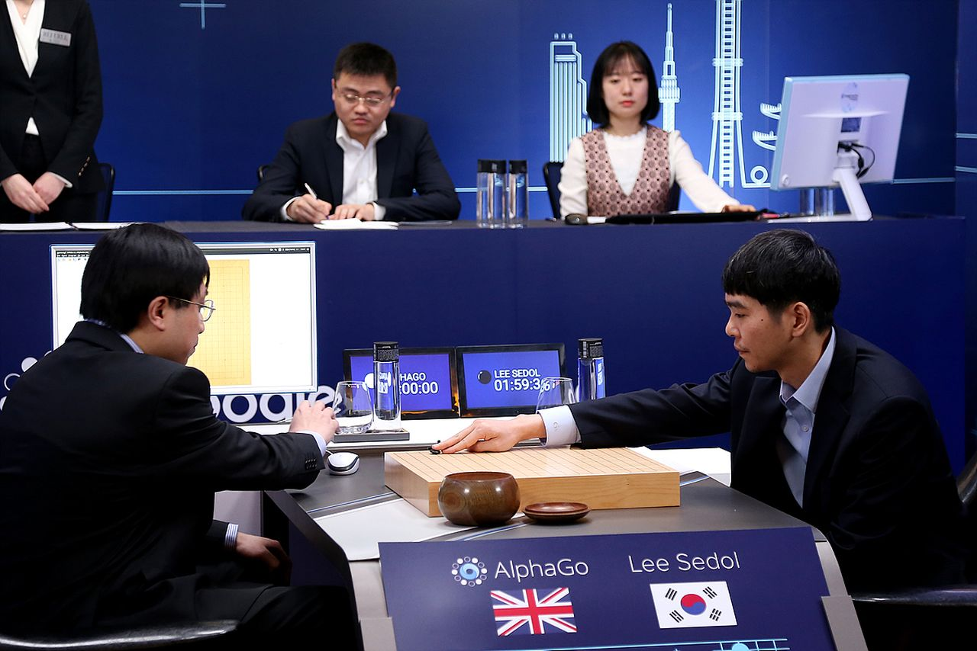
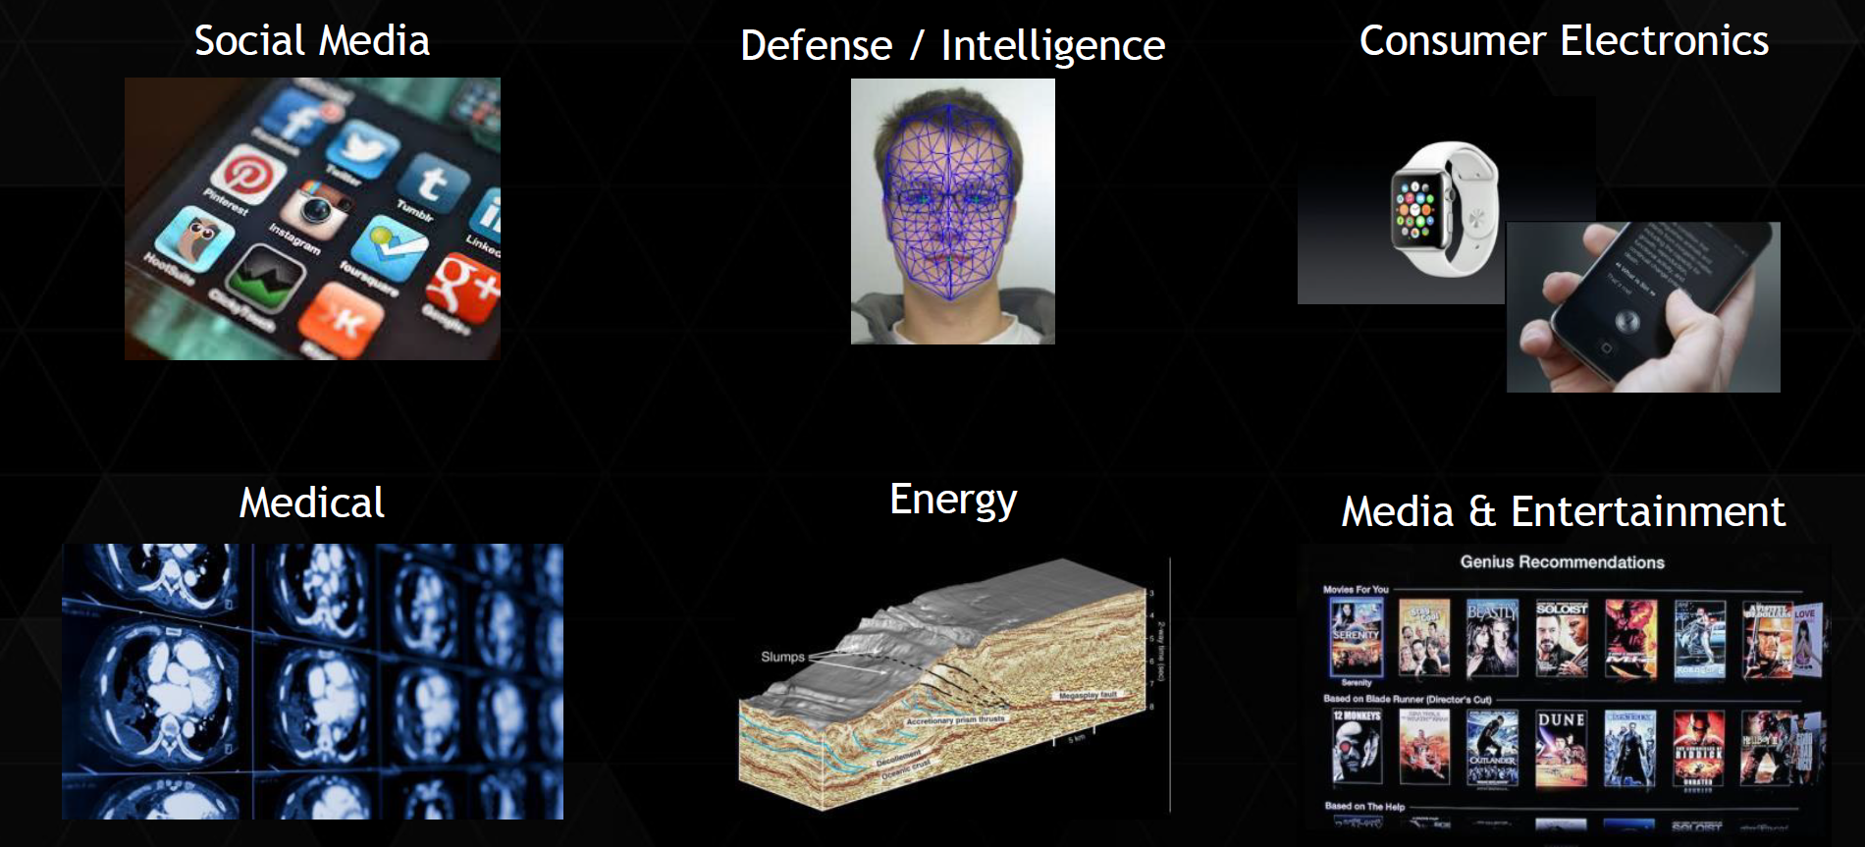
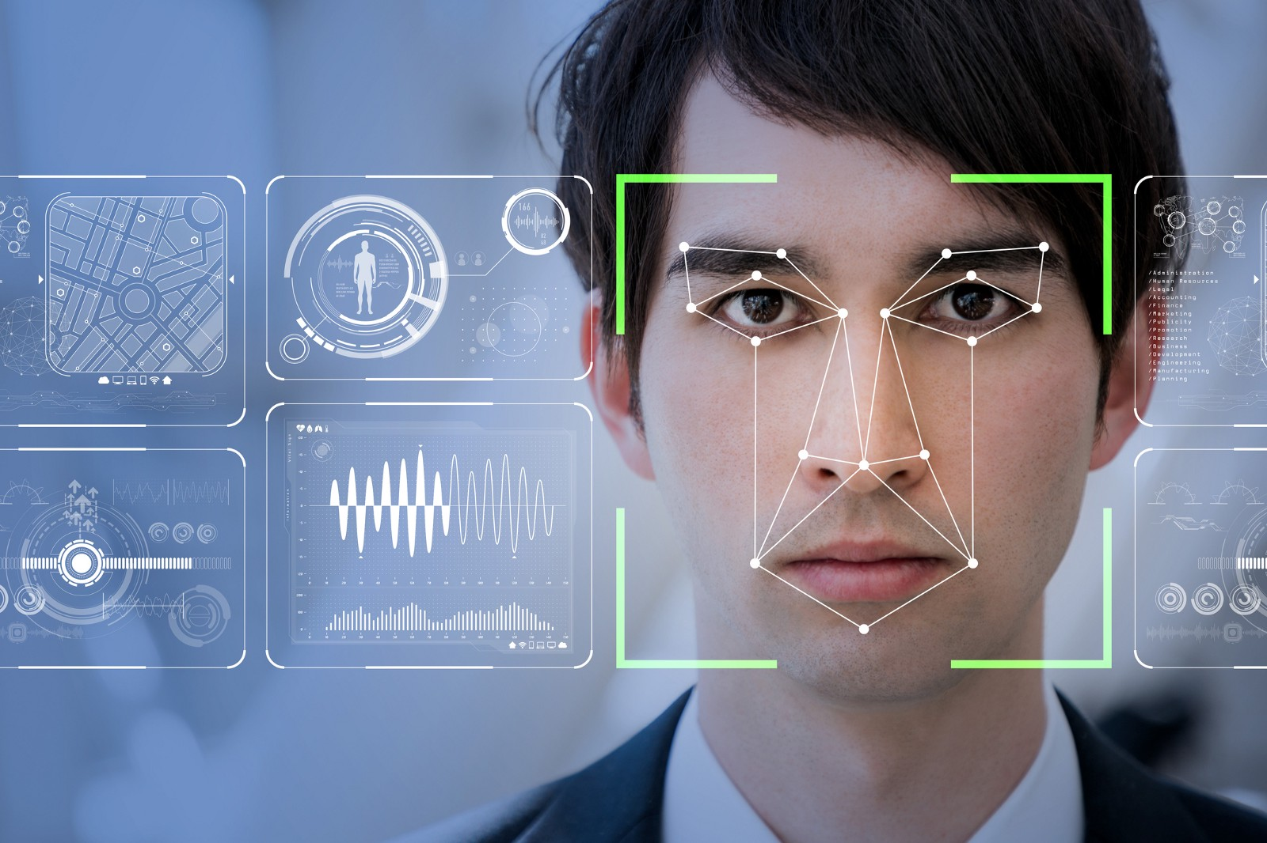
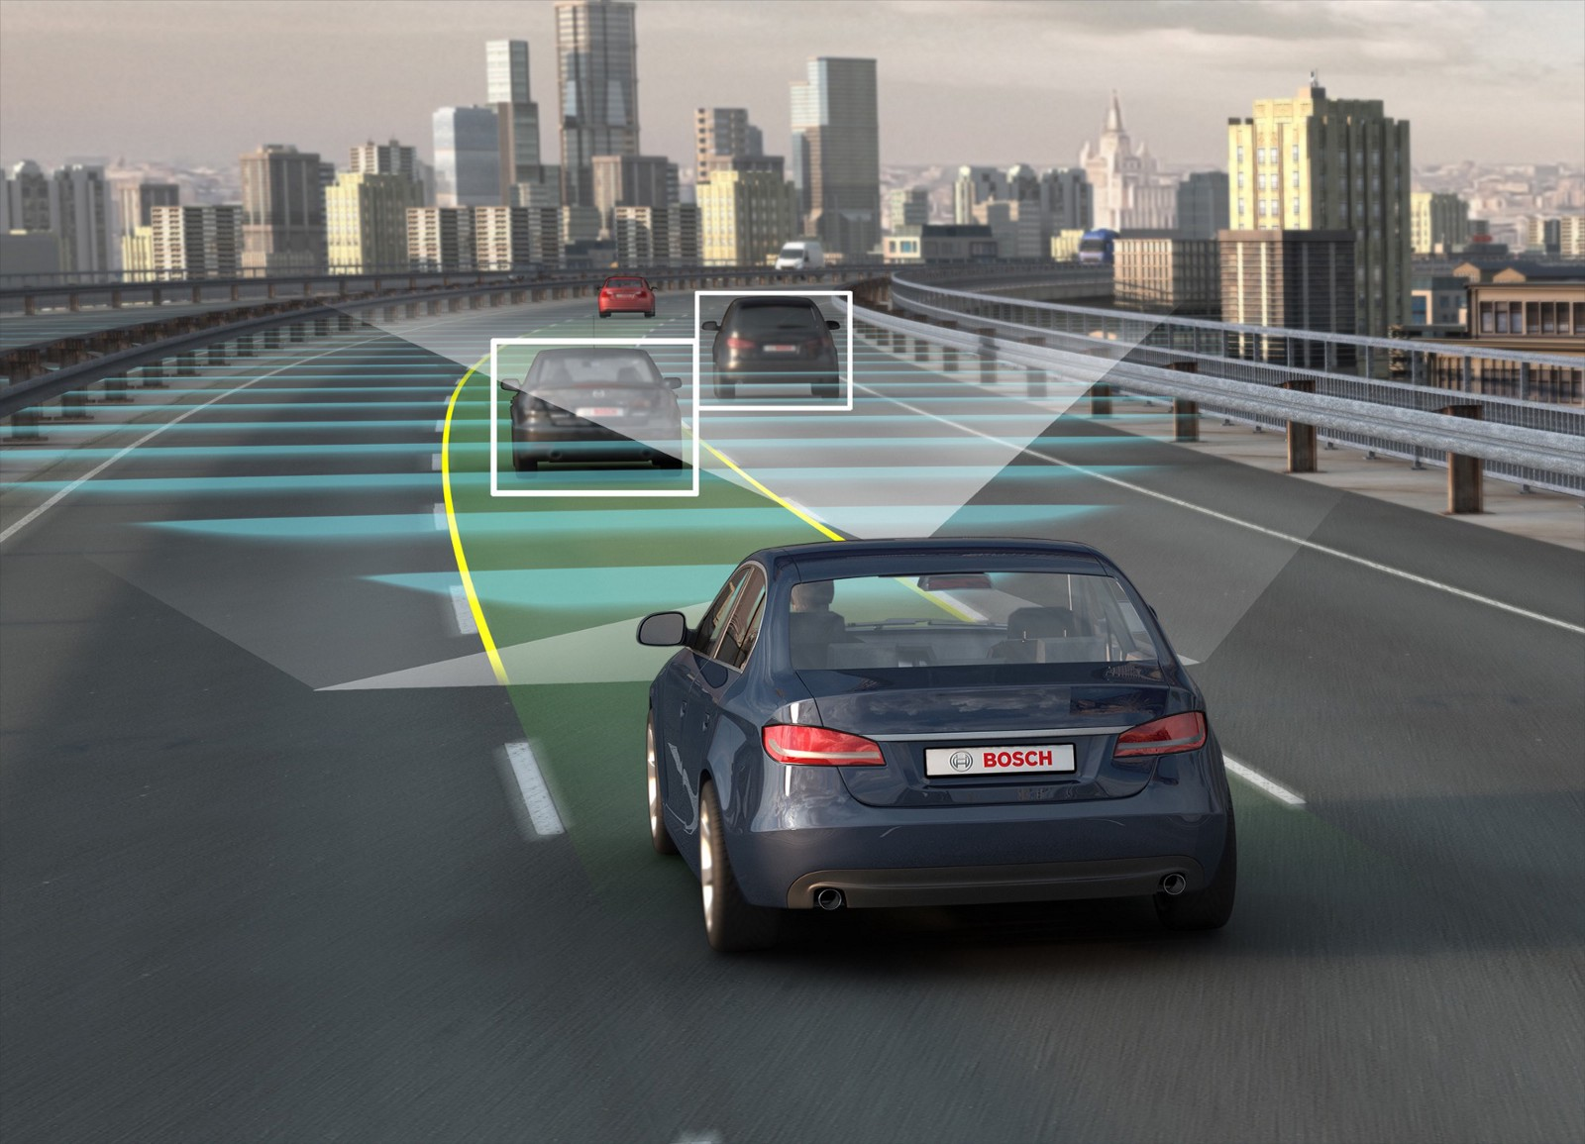
New Accelerator Design in Deep Learning Era
Deep learning has been rapidly adopted by numerous fields
Health System
Game Design
Personal Assistants
Social Media
Self-navigation vehicles
. . .

Slide 3
New Accelerator Design in Deep Learning Era
To design efficient accelerators for deep learning applications, we should understand the deep learning workloads first
We’ve been using various benchmark suites for this purpose such as SPEC, Rodinia, CUDA-SDK, PARSEC, … for general-purpose architectures

Slide 4






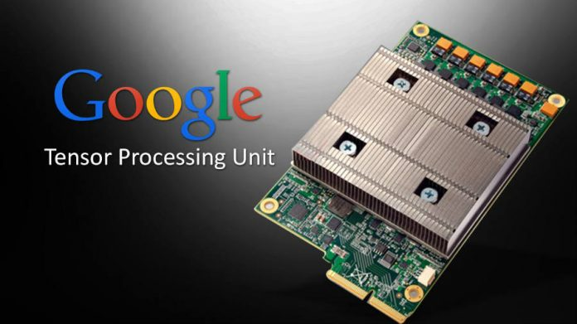
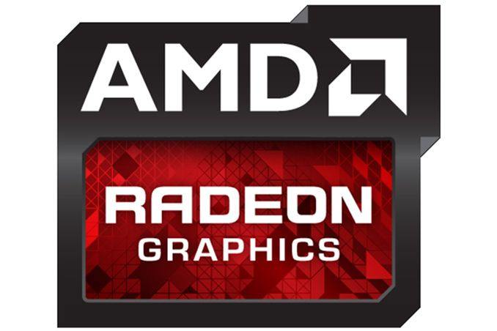
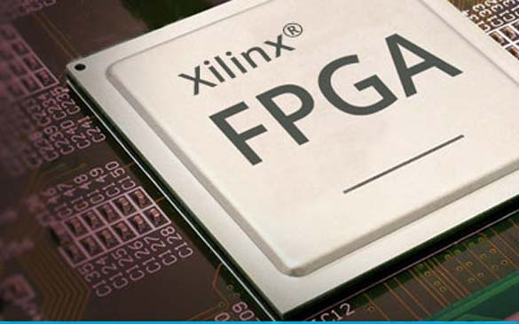

Challenges
New Accelerator
No common workloads that support various accelerators
Most DNN frameworks support only a certain GPU
New accelerators develop their own workloads that are not compatible with other accelerators
Hard to compare performance across accelerators
No common source of workloads that all accelerators can test with

Slide 5
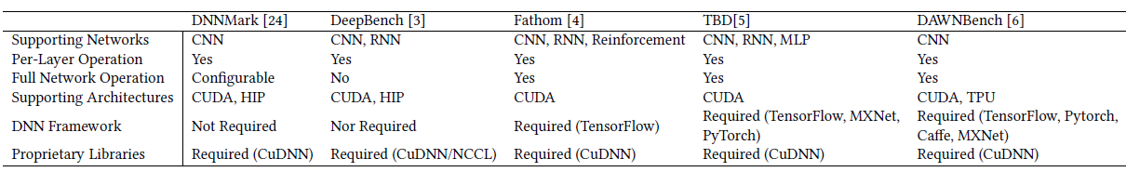
Existing DNN Benchmark Suites
DNNMark
Per-layer computation primitives for DNNs
Baidu DeepBench
CNN and RNN core kernels, which internally call DNN library functions
Fathom
TensorFlow scripts for eight DNN models
TBD
DNN training benchmark suite running on TensorFlow, MXNet, and CNTK
DAWNBench
Can test various hyper-parameters on the models written in PyToch and TensorFlow
All require proprietary DNN libraries and different DNN frameworks

Slide 6
A Light-weight Deep Neural Network Benchmark Suite for Various Accelerators
Tango,
Thus, we designed a deep learning benchmark suite, Tango, which supports
Pure CUDA- and OpenCL-based deep neural network computations
OpenCL is supported by various architectures
Tested with CUDA-based GPU devices, GPU architecture simulator, Intel CPU, and Xilinx FPGAs
Five+ most popular convolution neural networks
AlexNex, CifarNet, ResNet, SqueezeNet, VGGNet, MobileNet
Two most popular recurrent neural networks
GRU, LSTM
Opensource repository which can be updated easily
https://gitlab.com/Tango-DNNbench/Tango

Slide 7
A Light-weight Deep Neural Network Benchmark Suite for Various Accelerators
Tango,
Tango aims at providing a common testing environment
Such as the other GPU benchmark suites such as Rodinia, CUDA-SDK, ISPASS benchmark suite, and Parboil
That also supports non-CUDA accelerators
Without needing to install DNN frameworks and libraries
With various famous reference networks

Slide 8
To be Frank, Tango Is Not The Only Solution
Since we started this project 2 years ago, there have been a few orthogonal approaches that tackle the same problem
Most of them were pretty recently released
Nov 2018, GPGPU-Sim started supporting cuDNN (with some limitations) and modified PyTorch
TVM (OSDI’18), Glow (Facebook released in 2019), and TensorFlow XLA (2018) compilers generate DNN backend that can be compiled to various architectures machine code
There are some OpenCL DNN libraries (DeepCl)
Caffe supports OpenCL for AMD/Intel/Nvidia platforms (under development)

Slide 9
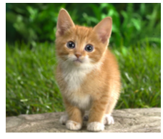
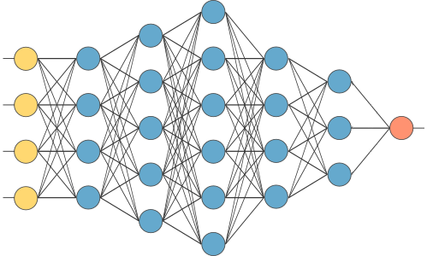
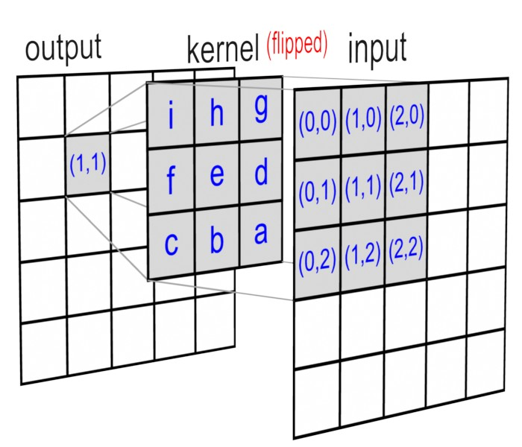

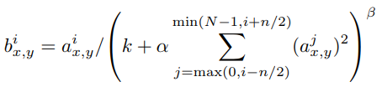

Code Structure (ex. CNN)
cat
CUDA/OpenCL Kernels
Convolution: Each thread handles
one neuron’s convolution function
Pre-trained model
Conv_layer 1
Weight file parser
Norm_layer
Activation: Each thread takes
Max(0, convolution result)
Pooling_layer
Per-layer
Weight,
Bias, Hyper-
parameters
Norm: Uses pre-trained model’s
Hyper parameters
Conv_layer 2
.
.
.
Max/Avg Pooling: Each thread
takes Max or Avg value out of the
given set of data
FC_layer 1
.
.
.
Each layer function is implemented
by referring to algorithms in papers, and code
of TensorFlow, Caffe, and Python
CUDA code is converted to OpenCL
and then converted to bitstream by using
FPGA HLS
One kernel per layer (similar to NN of
ISPASS benchmark suite)
Each layer output is checked with the DNN
Framework output

Slide 10
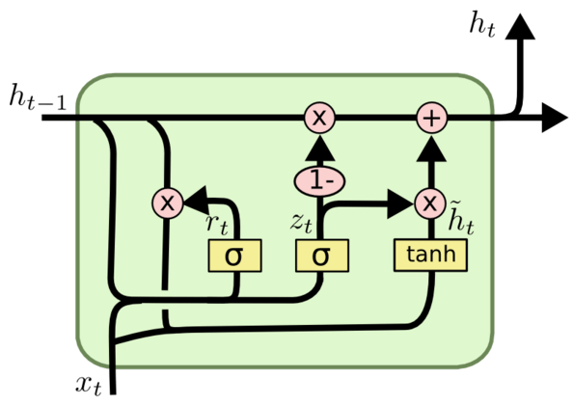
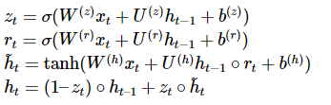
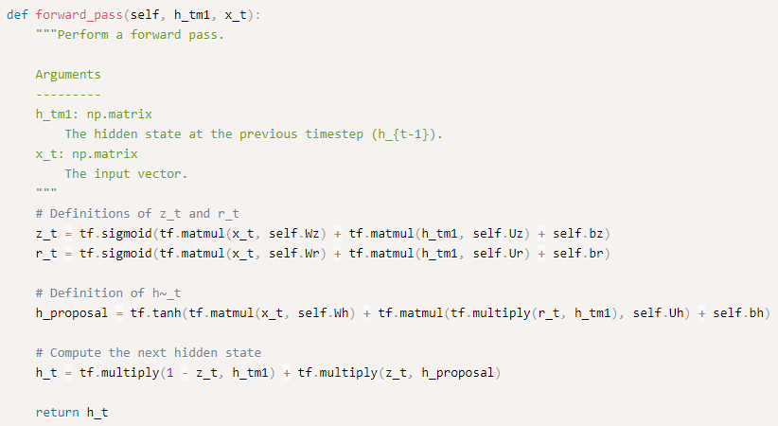
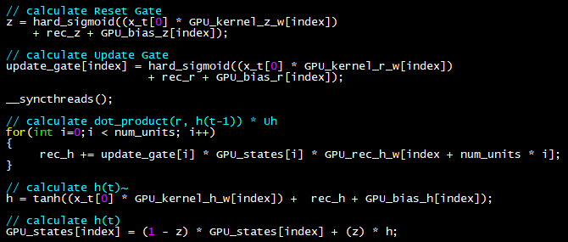
Code Snippet (ex. GRU)
< reference TensorFlow code >
< gru_kernel.cu >
(https://www.data-blogger.com/2017/08/27/gru-implementation-tensorflow/)

Slide 11
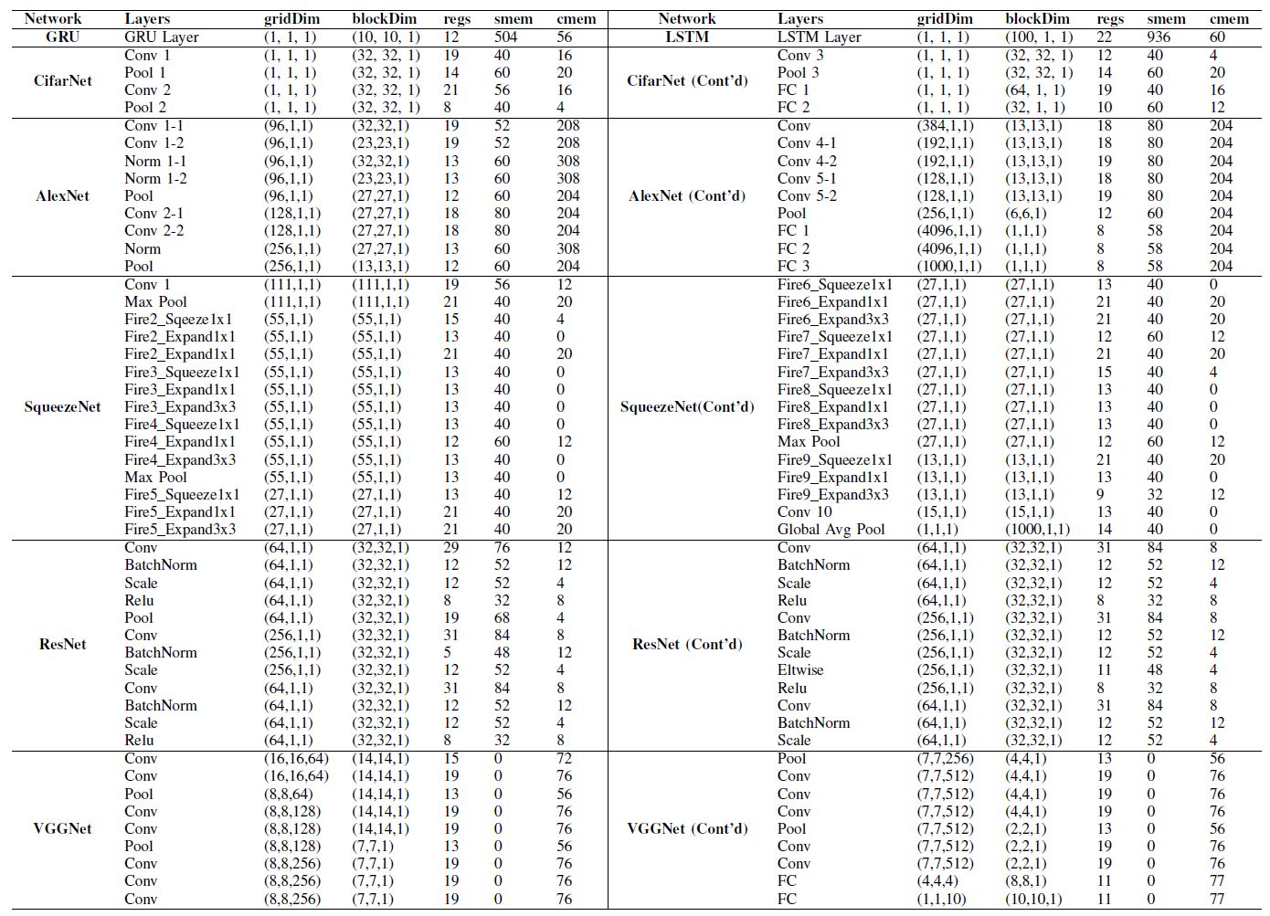
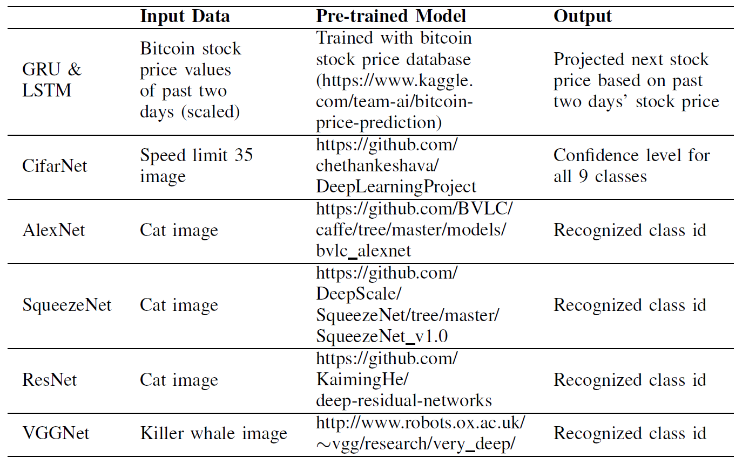
Configurations
Currently supports inference of full-network structures
Pre-trained models are sourced from various repositories
E.g., caffe model repository, original reference network model, …
Can be replaced if the model follows the original network
Tested with
NVIDIA GPUs (GK210 and TX1) & GPU architecture simulator (GPGPU-Sim)
Xilinx FPGA (PynQ)
Intel CPU
Network configuration and SRAM usage
Pre-trained models and test inputs

Slide 12
Correlation with DNN Framework-based Execution
Total kernel execution time of Tango is longer than Caffe because Tango is not optimized yet
But, due to model pre-processing and finer-grained kernel execution (a conv layer consists of 15~ kernels) of Caffe, end-to-end execution time is shorter in Tango for the most networks
Stall cycle breakdown (coalesced in similar type) show similar pattern
Conv has more pipeline resource related stalls, Pooling has more data dependency related stalls and FC has more mem related stalls

Slide 13
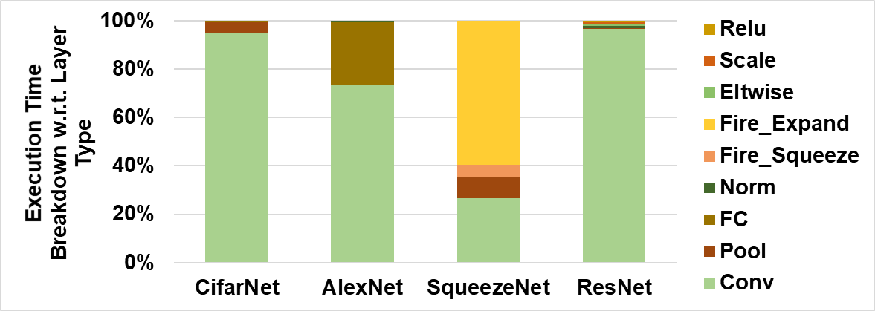
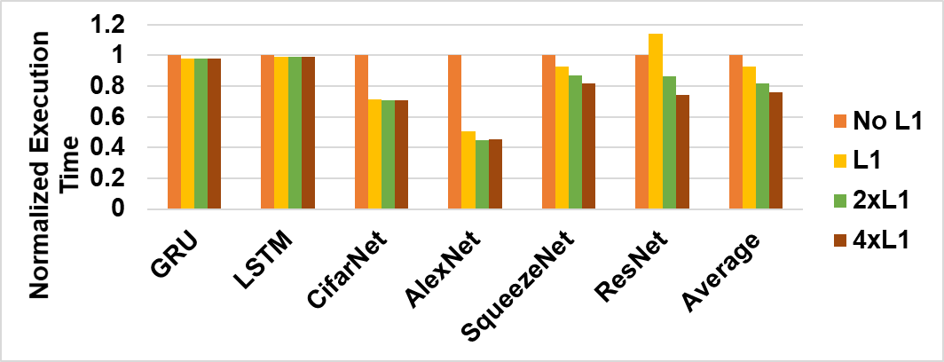
DNN Characterizations
Obs. 1) Convolution layer is the most time-consuming layer of CNNs, which may be the best target for optimization
Obs. 2) On-chip cache is helpful for improving the performance of CNNs while the impact of on-chip cache for RNNs is negligible

Slide 14
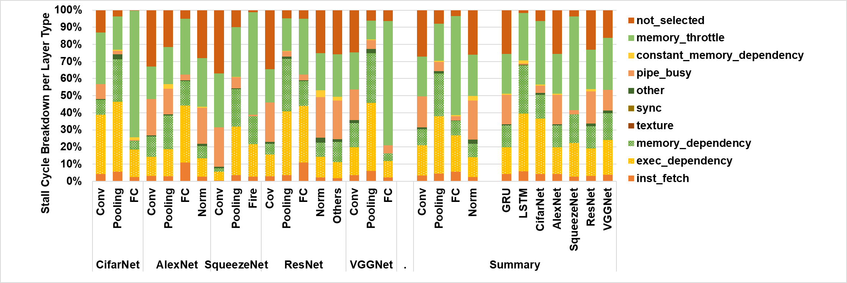
DNN Characterizations
Obs. 3) Stall cycle breakdown is a good indicator of layer types
Fully-connected layers suffer from memory throttling/dependency
Convolution and normalization layers encounter more stalls due to unavailable pipelines
Pooling layers show higher stall rates due to data dependency

Slide 15
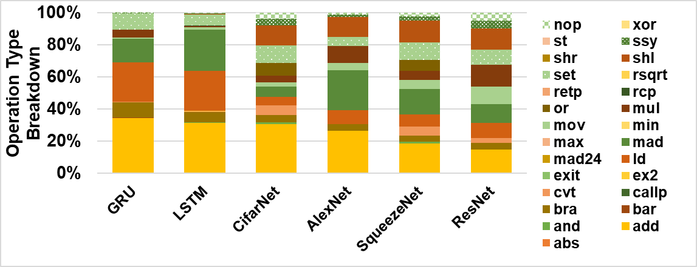
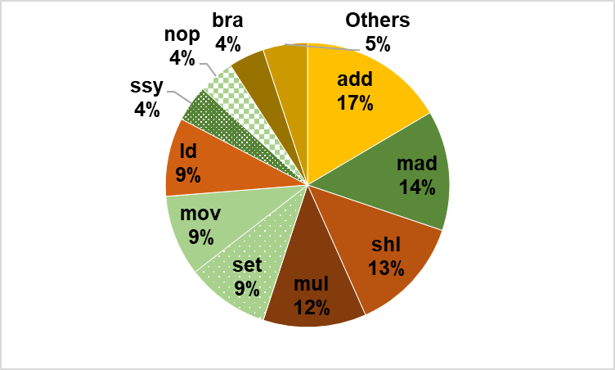
DNN Characterizations
Obs. 4) Operation breakdown is a good indicator of CNN and RNN
RNNs use add, ld, mad, and set instructions the most
CNNs also use shl and mul excessively
Obs. 5) Top four mostly executed operations are used for over a half of the entire execution
Total operations breakdown used by all networks:
Top 10 operations are used for 95% of execution

Slide 16
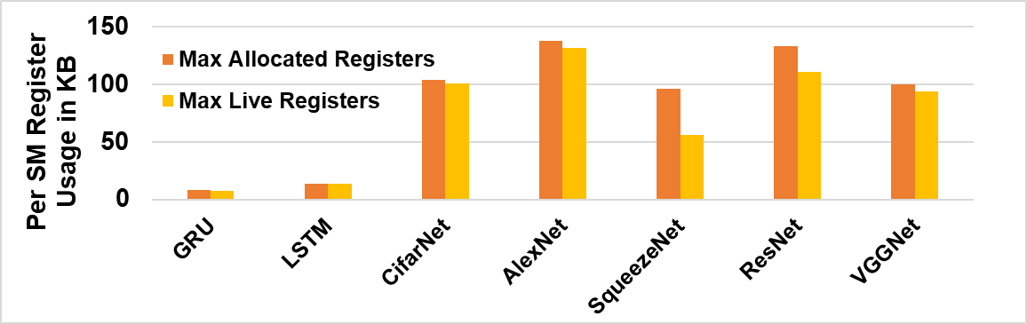
DNN Characterizations
Obs. 6) Though neural networks are compute-intensive workloads, GPU register file is significantly underutilized
Barely use 50% of per-SM register file of NVIDIA Pascal architecture
(This result may be different in the highly optimized kernels)

Slide 17
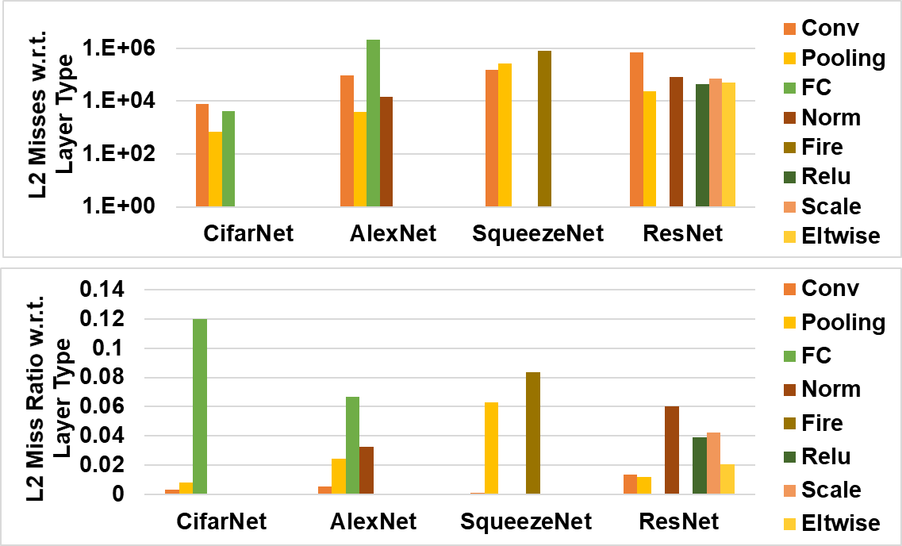
DNN Characterizations
Obs. 7) Convolution layers have high data locality and hence on-chip memory is mainly useful for optimizing the performance of convolution layers

Slide 18
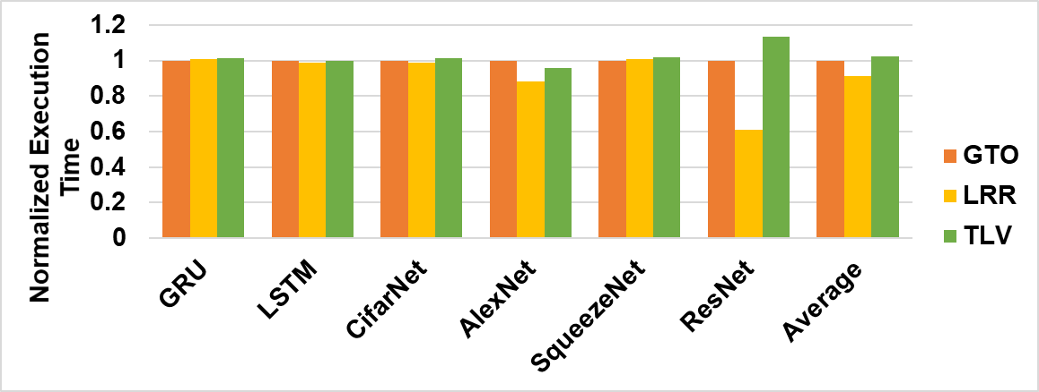
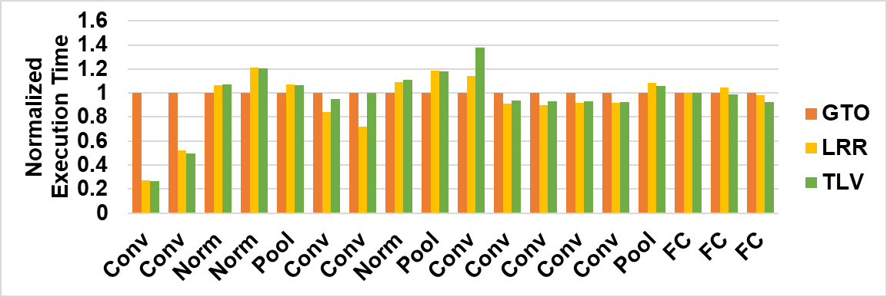
DNN Characterizations
Obs. 8) In some CNNs, the basic LRR warp scheduler shows better performance than advanced ones
The performance improvement is found especially in conv layers that have high data locality

Slide 19
DNN Characterizations
Obs. 9) FPGA may be faster and energy efficient than GPU for inference. However, the overhead of reconfiguration (e.g., bitstream downloading on demand) may offset the advantage.

Slide 20
Conclusion
We provide a quick evaluation environment that can test various performance metrics of different platforms with a few famous reference DNNs.
Findings
Though individual network structures are different, due to the same core algorithms, the same type networks (CNNs or RNNs) show similar statistics
Individual layer types have unique statistics
Conv suffers from busy pipeline, Pooling has higher data dependency, FC shows higher memory stalls
There are key layers (e.g., conv) and operations (e.g., mad, ld, add, shl, mul) that DNNs commonly spend more time, which can be good targets of optimization
We will keep updating the benchmark suite where the researchers can test impact of various optimizations and test more/newer DNNs

Slide 21
Thank you!

